Slide 1
CMPG315 — Computer Networks
Network Design &
Implementation
Group 13 | North-West University | 2026
Centralised Hierarchical Network | Router-on-a-Stick | VLAN Isolation

Slide 2
Project Overview
The Problem
An IT company expanding into a new single-storey office building needs a complete network connecting all sections while keeping them isolated from each other, sharing a single ISP internet connection, and keeping costs as low as possible. The new office space includes:
13 Offices VLAN 10 — 36 wired + 108 WiFi devices
Meeting Room VLAN 50 — 2 wired + up to 120 WiFi
Technicians Office VLAN 20 — 6 wired + 16 WiFi devices
Open Floor Space VLAN 60 — 100 wired + 300 WiFi
Reception VLAN 30 — 2 wired + staff & guest WiFi
Machine Room VLAN 70 — Servers + core network
Kitchen VLAN 40 — 4 IoT wired + 10 WiFi
Guest WiFi VLAN 99 — Sandboxed — internet only
Each member was responsible for designing, building, and testing their assigned section in Cisco Packet Tracer. Whenever we have challenges, we will help one another.
Wired: 50 Mb/s per device | WiFi: 10 Mb/s per device | Single ISP connection | All sections isolated

Slide 3
KEY CHALLENGES
Isolation: Each section must be completely isolated; for example, a reception PC cannot access the office PC
Single Internet Connection: One ISP fibre connection must be shared by all sections and all devices
Cost: The company has a limited budget, design must be affordable without sacrificing performance
Growth: The company must accommodate future growth without a complete redesign
Remote access: Staff working from home must be able to connect securely to the company network

Slide 4
ASSUMPTIONS AND INTERPRETATIONS
Servers: All servers, computers, and printers are already owned by the company and are excluded from the budget
ISP connection: The existing fibre ISP connection provides sufficient bandwidth for all devices. Only the internal network is designed.
Wired access points: Refers to wired Ethernet ports, not wireless access points
Packet Tracer devices: PC devices represent teleconferencing hardware in the meeting room. In real life, these would be dedicated video conferencing equipment.
Cable run: All cables run 100 metres, given the 100 * 50 metre size, so no repeaters are needed
Switch Policy: Company policy states that only switches with fewer than 8 ports may be placed outside the machine room. Switch PT is used as it is the smallest available in Packet Tracer.

Slide 5
Aim and objective
The purpose of this project is to design and test a smart, reliable, and affordable office network using Cisco Packet Tracer that makes everyday work easier for everyone. The network will be carefully structured so devices are organized and secure, with each department separated to protect their data while still sharing the same Internet connection. Staff will be able to connect both wired computers and multiple Wi‑Fi devices like laptops, phones, and tablets anywhere in the building, while still having easy access to shared tools such as printers and servers. The system will be built to handle growth, so as the company expands, the network can grow with it without needing a complete redesign. Finally, the entire setup will be simulated and tested in Cisco Packet Tracer to confirm that everything works smoothly before being put into real use. In short, the project aims to deliver a cost‑effective office network that is simple to use, safe for everyone, and ready for the future.

Slide 6
Network Topology
Centralised Hierarchical Design with Router-on-a-Stick
ISP Cloud / Internet
1941 Router — Router-on-a-Stick (8 sub-interfaces)
Core Switch + DHCP-DNS Server + Servers
Dist-Switch-1: Reception, Kitchen, Open Floor, Guest
Dist-Switch-2: Offices, Technicians, Meeting Room
VLAN 30
Reception
VLAN 40
Kitchen
VLAN 60
Open Floor
VLAN 99
Guest WiFi
VLAN 10
Offices
VLAN 20
Technicians
VLAN 50
Meeting Rm
All sections connect to machine room switches only — no large switches outside machine room

Slide 7
Network topology
The proposed network design follows a centralized hierarchical topology, where all critical networking infrastructure is in the machine room. This approach was selected to simplify management, enhance security, improve troubleshooting, and comply with company policy, which mandates that routers, servers, and major switches be housed in a single, secure location. By having all core components in one place, the network can be monitored and controlled more effectively, security policies can be enforced from a single point, and maintenance is streamlined. The building’s single-story layout supports this design, as the central machine room ensures all cable runs remain within the 100-meter Cat6 Ethernet limit, eliminating the need for repeaters or intermediate distribution layers.

Slide 8
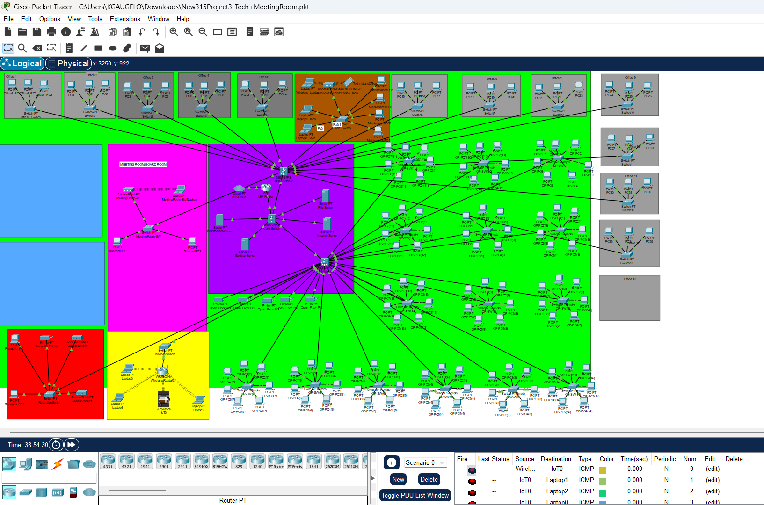
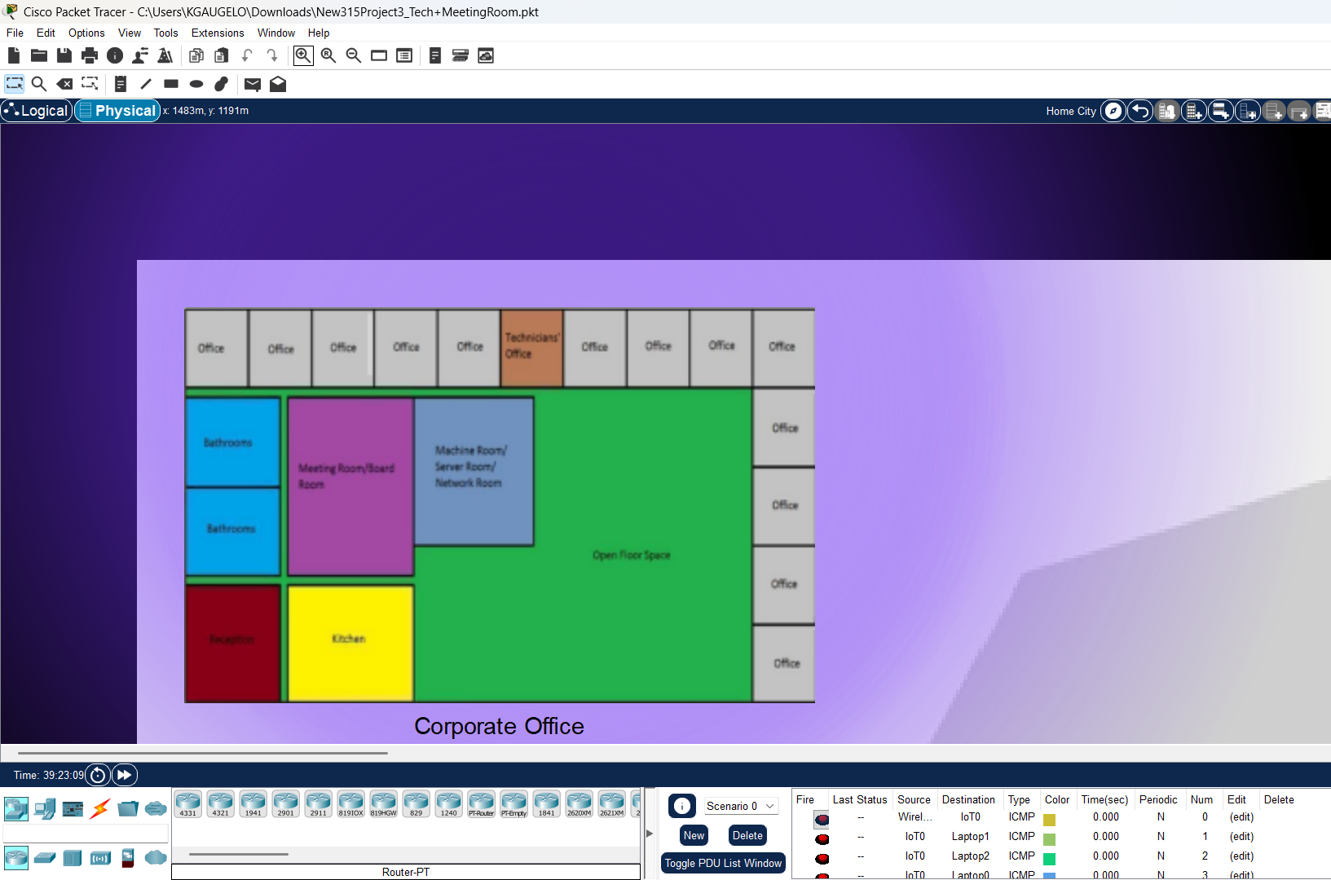
Physical network design
The logical and physical views in Packet Tracer both reflect the actual building layout as provided in the project diagram. Each section is placed in its correct position, matching the building floor plan.

Slide 9
VLAN Segmentation & Isolation
Section | VLAN | Subnet | Gateway | Dist Switch | Devices
Offices (13) | 10 | 192.168.10.0/24 | 192.168.10.1 | Dist-Switch-2 | 36 wired + 108 WiFi
Technicians | 20 | 192.168.20.0/24 | 192.168.20.1 | Dist-Switch-2 | 6 wired + 16 WiFi
Reception | 30 | 192.168.30.0/24 | 192.168.30.1 | Dist-Switch-1 | 2 wired + staff/guest WiFi
Kitchen | 40 | 192.168.40.0/24 | 192.168.40.1 | Dist-Switch-1 | 4 IoT wired + 10 WiFi
Meeting Room | 50 | 192.168.50.0/24 | 192.168.50.1 | Dist-Switch-2 | 2 wired + up to 120 WiFi
Open Floor | 60 | 192.168.60.0/23 | 192.168.60.1 | Dist-Switch-1 | 100 wired + 300 WiFi
Machine Room | 70 | 192.168.70.0/24 | 192.168.70.1 | Core Switch | Servers + core equipment
Guest WiFi | 99 | 192.168.99.0/24 | 192.168.99.1 | Dist-Switch-1 | Sandboxed — internet only
All inter-VLAN traffic blocked by ACLs | Internet access permitted for all VLANs | Guest WiFi sandboxed

Slide 10
Machine Room
VLAN 70
Role & Requirements
Packet Tracer Devices
Houses all core networking equipment
ISP-Router (1941): Router-on-a-Stick, NAT, firewall
Single ISP fibre connection point
Core-Switch (3650): Backbone, all VLANs and trunks
All servers already owned by company
Dist-Switch-1: Reception, Kitchen, Open Floor, Guest
Router-on-a-Stick for inter-VLAN routing
Dist-Switch-2: Offices, Technicians, Meeting Room
DHCP and DNS for all sections
DHCP-DNS-Server: IP assignment + DNS for all VLANs
FTP and HTTP intranet services
File-Server: Centralised file storage
Only location for switches >8 ports
Intranet-Server: HTTP intranet hosting
Backup-Server: Data backup and recovery
Subnet: 192.168.70.0/24 | Gateway: 192.168.70.1 | All major equipment centralised here to minimise cost

Slide 11
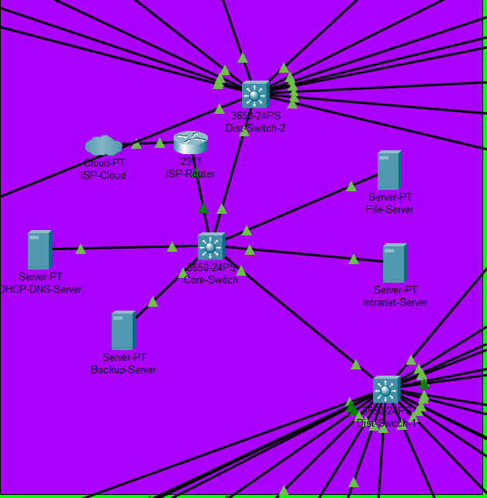

Slide 12
Offices (13 Active Offices)
VLAN 10
Requirements
Packet Tracer Devices
13 active offices, 3 people per office
Switch-PT: One per office (fewer than 8 ports)
36 wired network points for staff PCs
PC-PT x36: Wired staff computers
Each staff member: up to 4 WiFi devices
AccessPoint-PT: One per office for staff WiFi
108 WiFi devices total
Laptop-PT: Represents staff WiFi devices
Printer accessible within section
Printer-PT: Shared printer per office
Isolated from all other sections
Full internet access required
Subnet: 192.168.10.0/24 | Gateway: 192.168.10.1 | Connects to Dist-Switch-2 | DHCP from machine room | ACL blocks inter-section traffic

Slide 13
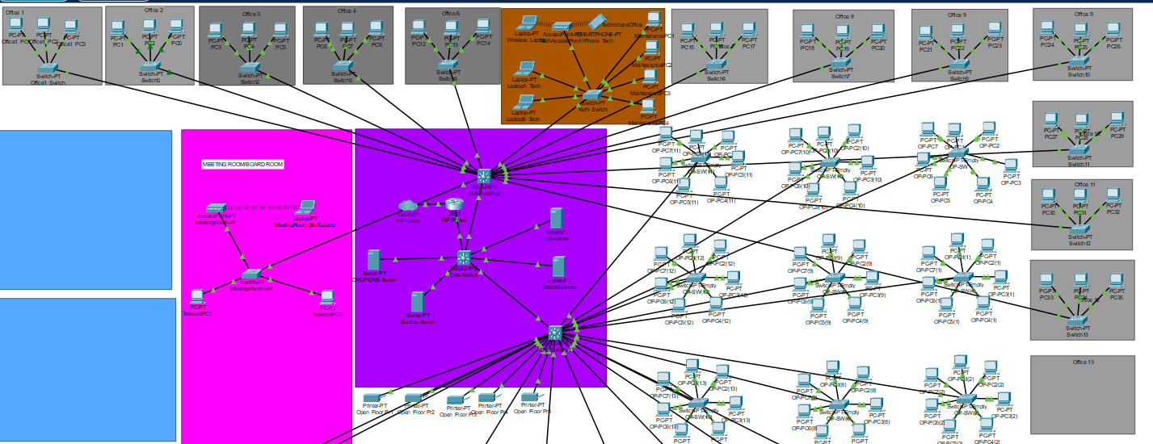

Slide 14
Technicians Office
VLAN 20
Requirements
Packet Tracer Devices
2 technicians managing the network
Switch-PT: Small access switch (<8 ports)
Direct wired access to machine room
PC-PT x6: 2 desktops + 4 maintenance ports
4 wired points for equipment maintenance
AccessPoint-PT: Staff WiFi for technicians
2 wired points for technician desktops
Laptop-PT: Represents WiFi devices
Up to 8 WiFi devices per technician
16 WiFi devices total
Isolated from all other sections
Subnet: 192.168.20.0/24 | Gateway: 192.168.20.1 | Connects to Dist-Switch-2 | Direct access to machine room for management

Slide 15
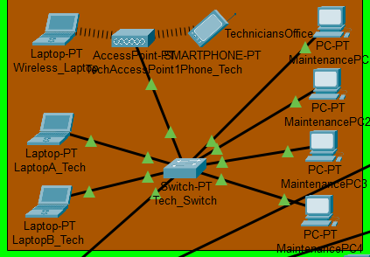

Slide 16
Reception
VLAN 30
Requirements
Packet Tracer Devices
2 reception staff with wired PCs
Switch-PT: Small access switch (<8 ports)
2 wired network points
PC-PT x2: Reception staff computers
Staff WiFi: up to 4 devices each
AccessPoint-PT: Staff WiFi + guest SSID (VLAN 99)
Guest WiFi available (VLAN 99)
Laptop-PT: Staff WiFi device for testing
Printer accessible within section
Printer-PT: Shared reception printer
Isolated from all other sections
Full internet access required
Subnet: 192.168.30.0/24 | Gateway: 192.168.30.1 | Connects to Dist-Switch-1 | Guest WiFi on VLAN 99 — sandboxed internet only

Slide 17
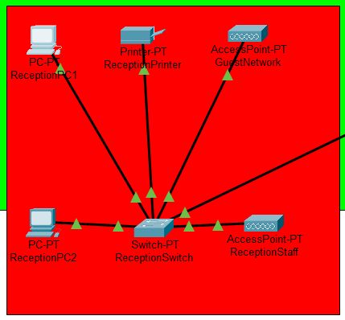

Slide 18
Kitchen
VLAN 40
Requirements
Packet Tracer Devices
IoT devices — smart appliances
Switch-PT: Small access switch (<8 ports)
4 wired network points for IoT
PC-PT x4: Represents 4 wired IoT devices
10 WiFi devices for staff
AccessPoint-PT: Staff WiFi in kitchen area
No sensitive data in this section
Laptop-PT: Represents staff WiFi devices
Isolated from all other sections
Full internet access required
No printer required
Subnet: 192.168.40.0/24 | Gateway: 192.168.40.1 | Connects to Dist-Switch-1 | IoT devices treated as untrusted | Isolated from all sections

Slide 19
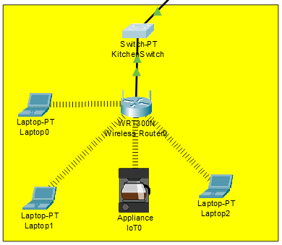

Slide 20
Meeting Room / Board Room
VLAN 50
Requirements
Packet Tracer Devices
20 to 30 people simultaneously
Switch-PT: Small switch (<8 ports) in room
Set up for teleconferencing
PC-PT x2: TeleconfPC1 and TeleconfPC2
2 wired Ethernet ports for hardware
AccessPoint-PT: Staff WiFi (SSID: MeetingRoom)
WiFi: up to 30 staff x 4 devices = 120
Laptop-PT: Staff wireless device for testing
Staff WiFi devices treated as untrusted
Isolated from all other sections
No printer — teleconferencing space
Subnet: 192.168.50.0/24 | Gateway: 192.168.50.1 | Connects to Dist-Switch-2 | Static IPs for PCs | DHCP for WiFi | ACL isolation confirmed

Slide 21
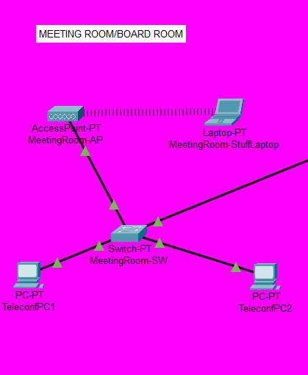

Slide 22
Open Floor Space
VLAN 60
Requirements
Packet Tracer Devices
75 to 120 staff members
Switch-PT x multiple: Multiple small switches for density
100 wired network points required
PC-PT x100: 100 wired staff workstations
/23 subnet — supports up to 510 devices
AccessPoint-PT: Multiple APs for coverage
300 WiFi devices for staff
Laptop-PT: Staff WiFi devices
Raised floor for cable management
Isolated from all other sections
Full internet access required
Subnet: 192.168.60.0/23 | Gateway: 192.168.60.1 | Connects to Dist-Switch-1 | /23 subnet for growth | Cables run under raised floor

Slide 23
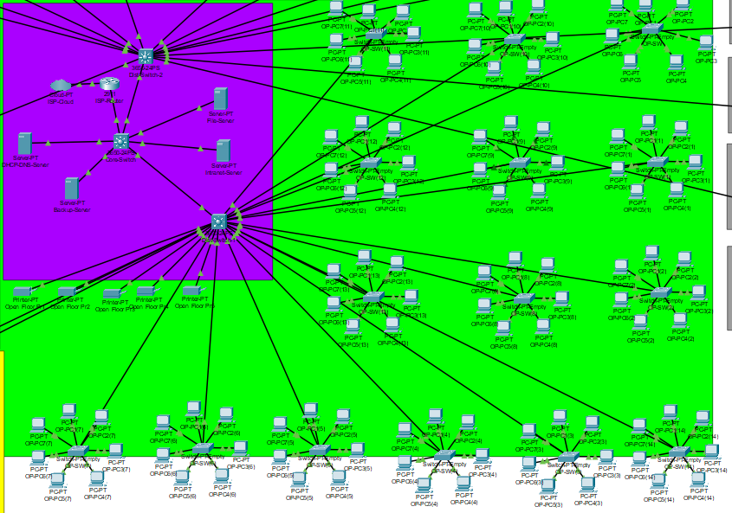

Slide 24
Guest WiFi
VLAN 99
What it is: A completely sandboxed wireless network for visitors and guests throughout the building.
How it works: Guest devices connect to the Guest SSID broadcast by access points in reception and other sections. They are placed on VLAN 99 automatically.
What guests can do: Access the internet only. No access to any internal section, server, printer, or device on any other VLAN.
How it is enforced: ACL on the distribution switch blocks all traffic from 192.168.99.0/24 to any internal subnet. Only internet traffic is permitted.
No extra hardware: Guest WiFi uses the same access points as staff WiFi. The AP broadcasts two SSIDs — one for staff (their section VLAN) and one for guests (VLAN 99).
Meeting room guests: Guests attending meetings use the building-wide VLAN 99 network. No extra hardware needed in the meeting room.
Subnet: 192.168.99.0/24 | Gateway: 192.168.99.1 | Internet access only | No lateral movement into internal network

Slide 25
REMOTE ACCESS SOLUTIONS + possible growth
VPN software: Cisco AnyConnect VPN creates an encrypted tunnel from the staff member’s home devices to the company network
Authentication: Multi-factor authentication is enforced; staff need a password plus a second factor to connect
Remote VLAN: Remote workers are placed on a dedicated VLAN with ACL restrictions; they can only access the file server and intranet( staff can access files from home)
Distribution switches have unused ports available for connecting new devices in the future
VLAN expansion: New VLANs can be added without hardware changes
DHCP pools: Each DHCP pool has more addresses than are currently needed; new devices will get addresses automatically.

Slide 26
Switch:
Connects multiple wired devices (e.g., PCs, printers) within a local area network (LAN).
Forwards data only to the specific device it's intended for, improving network efficiency.
Access Point (AP):
Provides wireless connectivity to allow Wi-Fi-enabled devices to join the network.
Acts as a bridge between wired LAN and wireless clients.
Printer (Networked):
Enables multiple users to print documents over the network without a physical connection.
Can be managed remotely for monitoring and maintenance.
Server:
Hosts resources such as files, applications, and network services (e.g., DHCP, DNS).
Provides centralized control and data storage for users across the network.
Router:
Connects different networks (e.g., LAN to the Internet) and directs traffic between them.
Assigns IP addresses and often includes firewall functions for security.

Slide 27
Security & Remote Access
VLAN Isolation
Access Control Lists
Each section on its own VLAN. Devices in one section cannot reach devices in another even on the same physical network.
ACLs on distribution switches block all inter-VLAN traffic while permitting internet access for all sections.
NAT & Firewall
WPA2-PSK WiFi
Router performs NAT for internet access and blocks unsolicited incoming connections from external networks.
All access points use WPA2-PSK encryption. Staff and guest networks use separate SSIDs mapped to different VLANs.
VPN Remote Access
BYOD Policy
Cisco AnyConnect VPN provides encrypted remote access for staff. Multi-factor authentication enforced.
Personal devices treated as untrusted. Connected on staff VLANs with ACL restrictions. Must support WPA2.
Multiple security layers: VLANs + ACLs + NAT + WPA2 + VPN

Slide 28
Budget Overview
Item | Qty | Total (ZAR)
Cisco 1941 Router | 1 | R 2250
Distribution Switches (3650) | 2 | R 31,116
Small Switches (<8 port) | 30 | R 12,600
Wireless Access Points | 8 | R 11,352
Cat6 Cabling (305m drums) | 4 | R 4300
Patch Panels + Network Rack | 2 | R 1150
Wall Plates + Keystone Jacks | 30 | R 570
Cable Trunking (50mm x 3m length) | 40 | R 22,356
VPN Licence (Cisco AnyConnect) | 1 | R 18,644.80
Labour — 9 days, network technician | 3 technicians | R 13,500
Contingency 20% ( unforeseen expenses) |  | R 23,567.76
TOTAL |  | R 141,406.56
Key Notes
Prices from South African retailers
Servers and PCs excluded — owned
Network technician rate: R3,000/day
No engineers — not required
20% contingency included
Real-world prices verified online
Labour covers full installation
Budget based on current South African market prices | 20% contingency included | Labour for network technicians only

Slide 29
Network Evaluation
What Works Well
What Is Problematic
Centralised management — all equipment in one place
Single point of failure — no redundancy
Cost efficient — one router handles all VLANs
Cable congestion through ceiling spaces
Scalable — add devices without redesigning
One AP per section — limited WiFi capacity
Multiple security layers — VLANs, ACLs, NAT, WPA2
Router bottleneck under very heavy load
DHCP centralised — automatic IP management
No redundant internet connection
Two distribution switches — reduces bottleneck
Most maintenance: cabling through ceiling — use labelled cable trays and patch panels for easy fault finding.
If company goes virtual: ISP router, VPN server, and file servers remain — physical cabling and switches no longer needed

Slide 30
Conclusion
✓ Network fully designed and implemented in Cisco Packet Tracer
✓ All 7 sections isolated via VLANs and ACLs — tested and confirmed
✓ Internet access working for all sections through single ISP connection
✓ Router-on-a-Stick on Cisco 1941 — one router handles all 8 VLANs
✓ Three distribution switches
✓ DHCP centralised on machine room server — automatic for all sections
✓ Meeting room: 2 wired teleconferencing ports + WiFi for 120 devices
✓ Guest WiFi sandboxed on VLAN 99 — internet only, no internal access
✓ Budget of R111,600 based on real South African market prices
✓ Remote access via Cisco AnyConnect VPN with multi-factor authentication
Thank you — Group 13 | CMPG315 | 2026

